Slide 1
Autonomous Flag Finder
Burnout Squad
Jeremiah McCutcheon: Project Manager
David Koblah: Hardware Design
Michael Bates: Software Design

Slide 2
System Description
This system is an autonomous robot designed to locate, identify and retrieve flags inside a room or maze.
It will utilize a camera and proximity sensors to navigate its environment.
The camera will wirelessly communicate with a computer in order to identify flags and retrieve them.
A microcontroller will control the movement of the tank, proximity sensors and servo motors to rotate the camera or retrieve the flags.
David Koblah

Slide 3
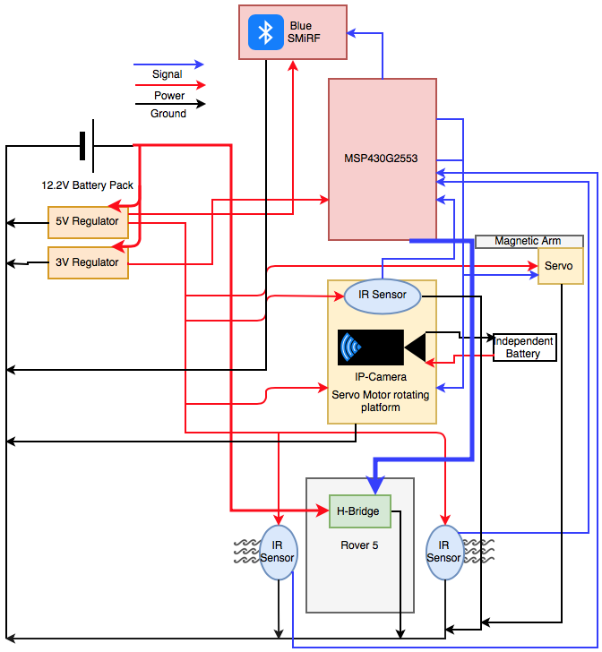
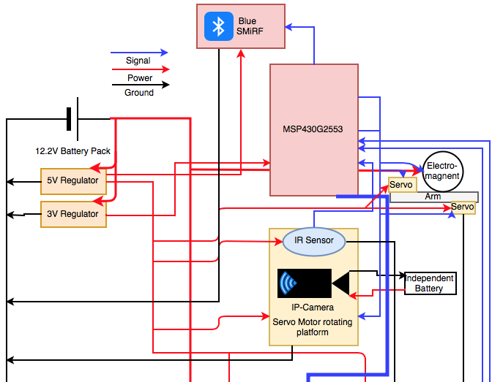
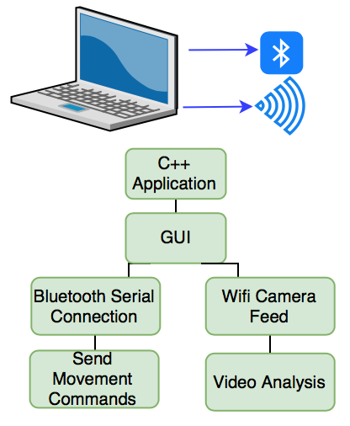
System Diagram
Ultra sonic Sensor
Ultra sonic Sensor
David Koblah

Slide 4
Division of labor
Jeremiah: Bluetooth Serial Communication Interface with Mac, Video Camera Interface with Mac, Image Processing
David: BlueSMiRF receiving communication, Servo arm and Electromagnet interface, Flag Collection
Michael: IR sensor implementation, Ultrasonic Sensor implementation, Autonomous Navigation, PCB, Budget
Michael Bates

Slide 5
Safety Concerns
Our primary safety concern this week has been managing the 9.6V battery to avoid any fires and over volting microcontroller circuits. We may also add a warning signal to our design to prevent fellow lab users from running into the rover.
Making sure not to connect to TTU with lab router.
Wearing appropriate Personal Protective Equipment
Pants
Closed Toed Shoes
Safety Glasses
David Koblah

Slide 6
Last Week’s Deliverables
Jeremiah
Prototype C++ GUI✅
Begin IP camera integration✅
Begin ‘blob identification’ code✅
David
Order parts and begin construction of robot arm✅
Produce sample images to begin analysis❌
Michael
Begin Ultrasonic Sensor interface✅
Continue Researching Image Processing❌
Michael Bates

Slide 7
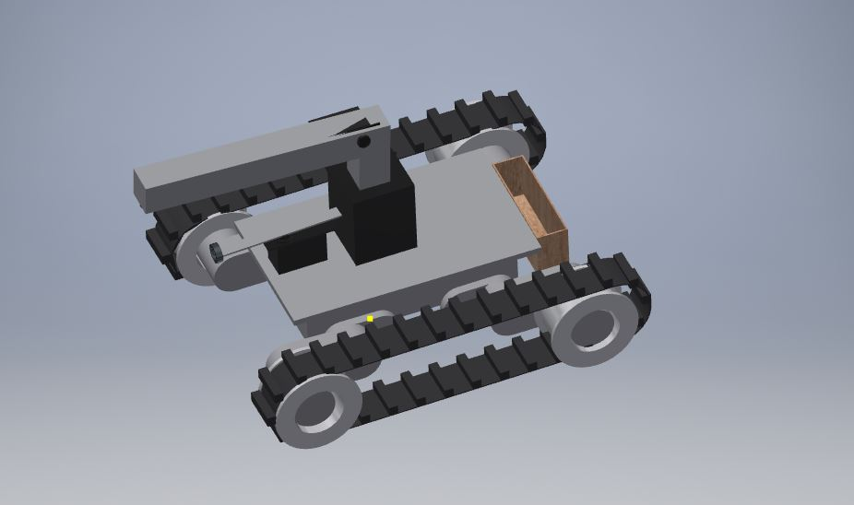
Basic Robot Design
Servo Joint for up-down movement
Expansion Area
Flag Holder
Electromagnet Position
IP Camera Position
David Koblah

Slide 8
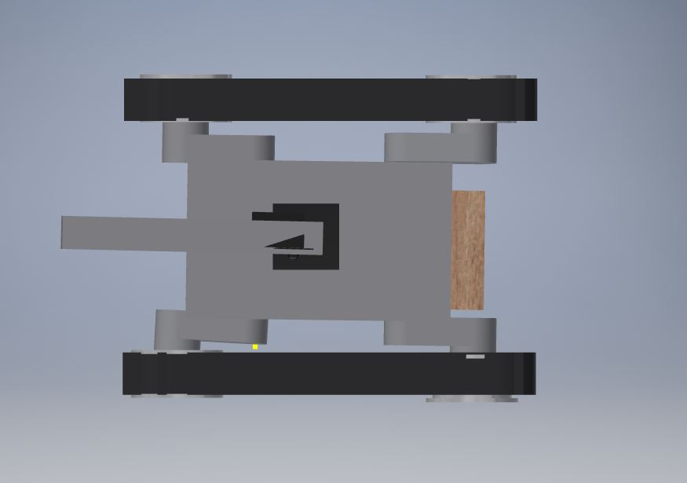

Top View
Circular rotation
David Koblah

Slide 9
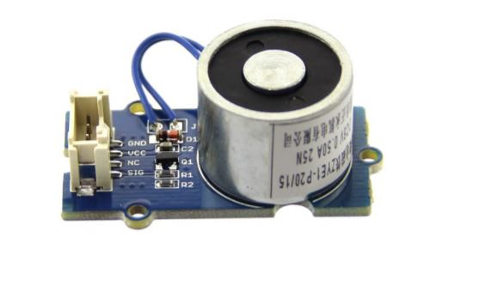
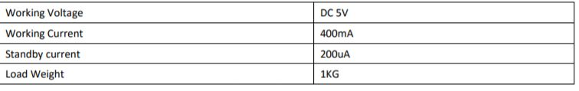
Electromagnet (Revised)
David Koblah
Mouser.com [1]

Slide 10
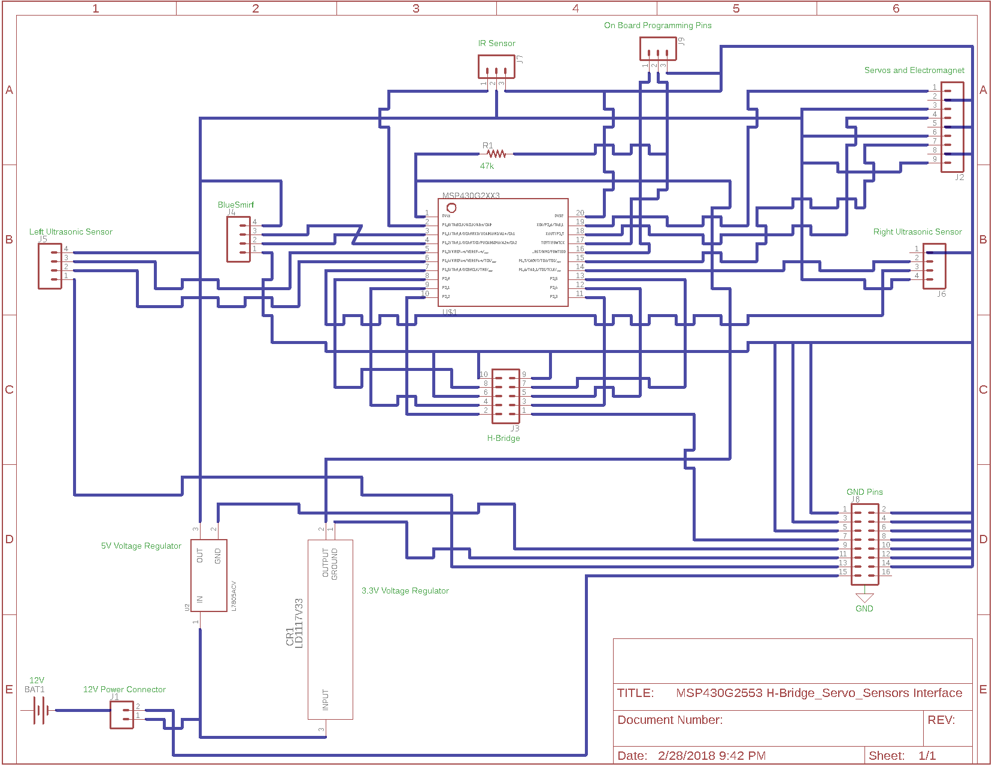
Eagle Schematic
Michael Bates

Slide 11
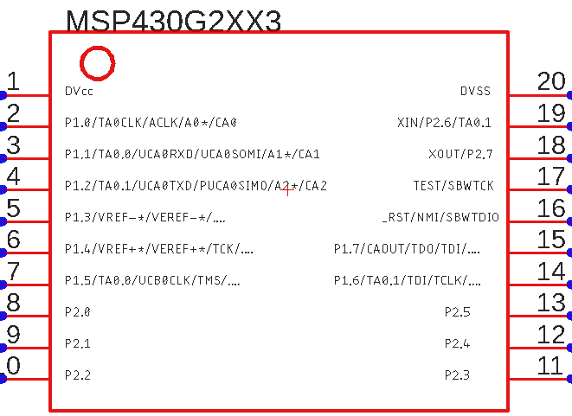
Microcontroller
3.3V Regulator
GND
IR Sensor
Servo 1
BlueSmirf RX
Servo 2
On Board Programming
BlueSmirf TX
Left Ultrasonic Sensor Trigger
On Board Programming
Left Ultrasonic Sensor Echo
Electromagnet
Right Ultrasonic Sensor Trigger
Right Ultrasonic Sensor Echo
EN B
EN A
IN 3
IN 4
IN 1
IN 2
Michael Bates

Slide 12
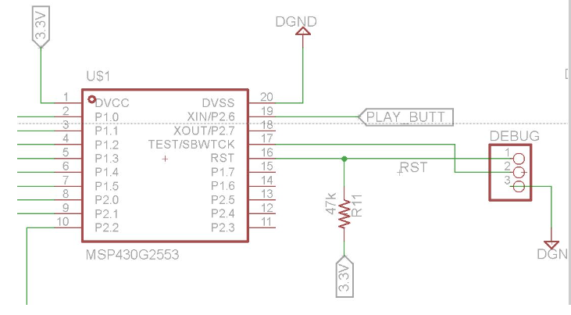
On Board Programming
Michael Bates
Troy Davis [7]

Slide 13
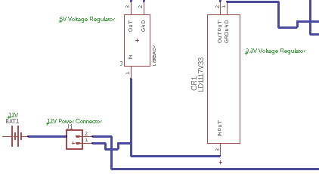
Power
Michael Bates

Slide 14
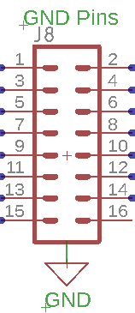
Ground
Michael Bates

Slide 15
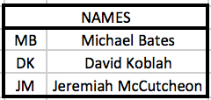
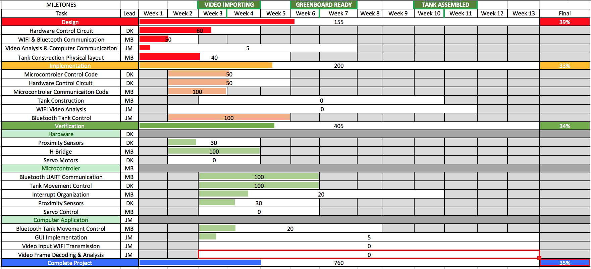
Gantt Chart
Michael Bates

Slide 16
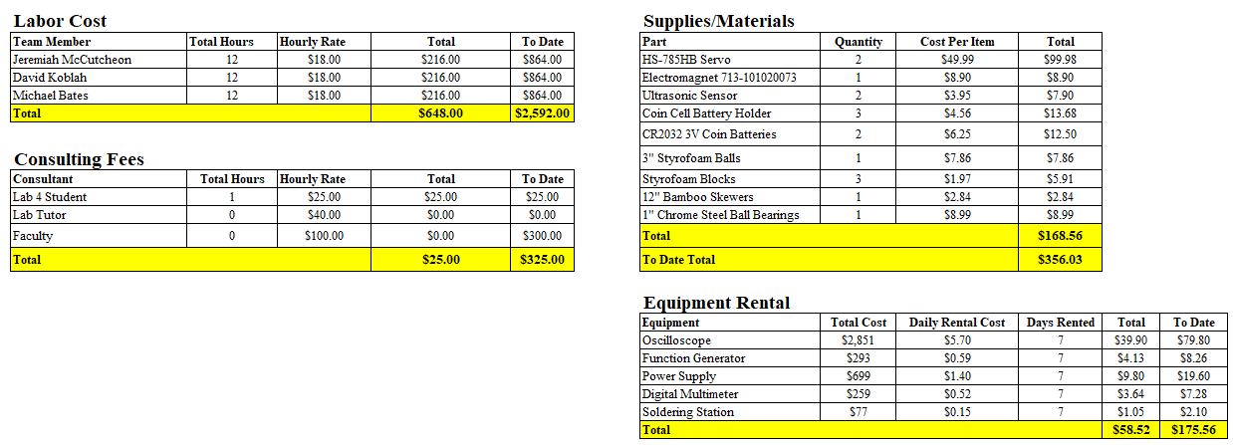
Budget
Michael Bates

Slide 17
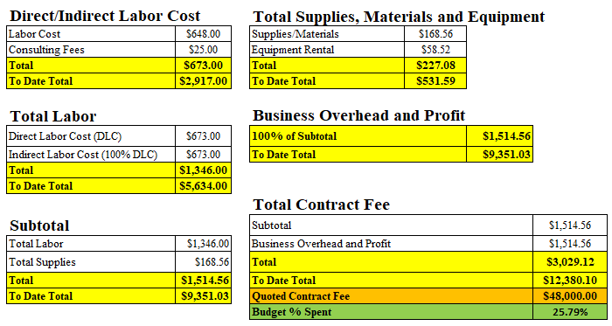
Budget Continued
Michael Bates

Slide 18
Next Week’s Deliverables
Jeremiah
Continue Working on C++ GUI
Continue IP Camera Integration
Continue Working on ‘Blob Identification’ Code
David
Continue Constructing Servo Arm
Begin Servo Arm Code
Michael
Finish PCB Design
Finish Maze Navigation Code
David Koblah

Slide 19
References
[1]Mouser.com https://www.mouser.com/ds/2/744/Seeed_101020073-1217554.pdf
[2] Troy Davis, ECE Undergraduate Student, Texas Tech University

Slide 20
Questions?

